Slide 1

CS1951 L
Blockchains & Cryptocurrencies
Spring 2025
Lecture 10
Solidity Pitfalls and Hazards
(Part Two)
Maurice Herlihy
Brown University

Slide 2

Today’s Pitfalls:
Default Visibility
False Randomness
Unchecked return values
Parameter Attack

Slide 3

Default Visibility Attack
Which contracts can call your contract’s functions?
External: only others
Private: only current, not derived contracts
Internal: only current or derived contracts
Public: any contract
(Also describes fields, but they’re visible via Etherscan, etc.)

Slide 4
Default Visibility Attack
Which contracts can call your contract’s functions?
External: only others
Private: only current, not derived contracts
Internal: only current or derived contracts
Public: any contract
(formerly)
default

Slide 5
Fallback Function
Remember, transaction data includes:
Function selector (hashed name)
Function arguments

Slide 6
Fallback Function
contract Example {
uint x = 0;
function foo() public {
x = 1;
}
fallback() external payable {
x = 2;
}
}

Slide 7
Fallback Function
contract Example {
uint x = 0;
function foo() public {
x = 1;
}
fallback() external payable {
x = 2;
}
}
regular
function

Slide 8
Fallback Function
contract Example {
uint x = 0;
function foo() public {
x = 1;
}
fallback() external payable {
x = 2;
}
}
regular
function
special
fallback
function
Often used to receive payments

Slide 9
Function Call
Contract A
Contract B
not me!
call “bar”
fn foo()
me!
fn bar()
fn fallback()
A calls B’s “bar” function …

Slide 10
Wallet Library
Does most of the work
Wallet Library
fn transfer()
Delegatecall: updates wallet internal state only
fn credit()
fn init ()
Also, init() function called internally by constructor to initialize owners, etc.

Slide 11
Composite Wallet
Wallet
Wallet Library
call “transfer”
fn transfer()
fn transfer()
fn credit()
fn credit()
…
fn init ()
fn fallback()
Most calls just forwarded to library

Slide 12
Wallet Library Security Audit
contract WalletLibrary {
address owner; // called by constructor
function initWallet(address _owner) {
owner = _owner;
// ... more setup ...
}
…
}

Slide 13
Wallet Library Security Audit
contract WalletLibrary {
address owner; // called by constructor
function initWallet(address _owner) {
owner = _owner;
// ... more setup ...
}
…
}
Initialization code called only by constructor.

Slide 14
Wallet Library Security Audit
contract WalletLibrary {
…
fallback() external payable {
// ... receive money, log events, ...
}
}
Anyone can deposit money in wallet

Slide 15
Wallet Library Security Audit
contract WalletLibrary {
…
function withdraw(uint amount) external
returns (bool) {
if (msg.sender == owner) {
return owner.send(amount);
} else {
false;
}
}
}
Only owner can withdraw money

Slide 16
Wallet Fallback Function
fallback() external payable {
// just receiving cash?
if (msg.value > 0)
Deposit(msg.sender, msg.value);
else if (msg.data.length > 0)
walletLibrary.delegatecall(msg.data);
}
}

Slide 17
Wallet Fallback Function
fallback() external payable {
// just receiving cash?
if (msg.value > 0)
Deposit(msg.sender, msg.value);
else if (msg.data.length > 0)
walletLibrary.delegatecall(msg.data);
}
Deposit if someone is sending money

Slide 18
Wallet Fallback Function
fallback() external payable {
// just receiving cash?
if (msg.value > 0)
Deposit(msg.sender, msg.value);
else if (msg.data.length > 0)
walletLibrary.delegatecall(msg.data);
}
Otherwise, pass call through to library …

Slide 19
Uh, Oh
contract WalletLibrary {
address owner; // called by constructor
function initWallet(address _owner) {
owner = _owner;
// ... more setup ...
}
…
}
Oh wait, where was initWallet() visibility declared?
(It isn’t …)
It had default public visibility!

Slide 20
Uh, Oh
Library’s initWallet() callable by anyone!
contract WalletLibrary {
address owner; // called by constructor
function initWallet(address _owner) {
owner = _owner;
// ... more setup ...
}
…
}
Oh wait, where is initWallet visibility declared?
(It isn’t …)
It had default public visibility!

Slide 21

Composite Wallet
Wallet
Call
“initWallet(me)”
Wallet Library
Not me!
fn transfer()
fn transfer()
Not me!
fn credit()
fn credit()
…
fn initWallet ()
No idea, just forward
to library!
fn fallback()

Slide 22
Composite Wallet
Wallet
Call
“initWallet(me)”
Wallet Library
I’m public,
so why not?
fn transfer()
fn transfer()
fn credit()
fn credit()
…
fn initWallet ()
Relay call
fn ()
Welcome new owner!

Slide 23

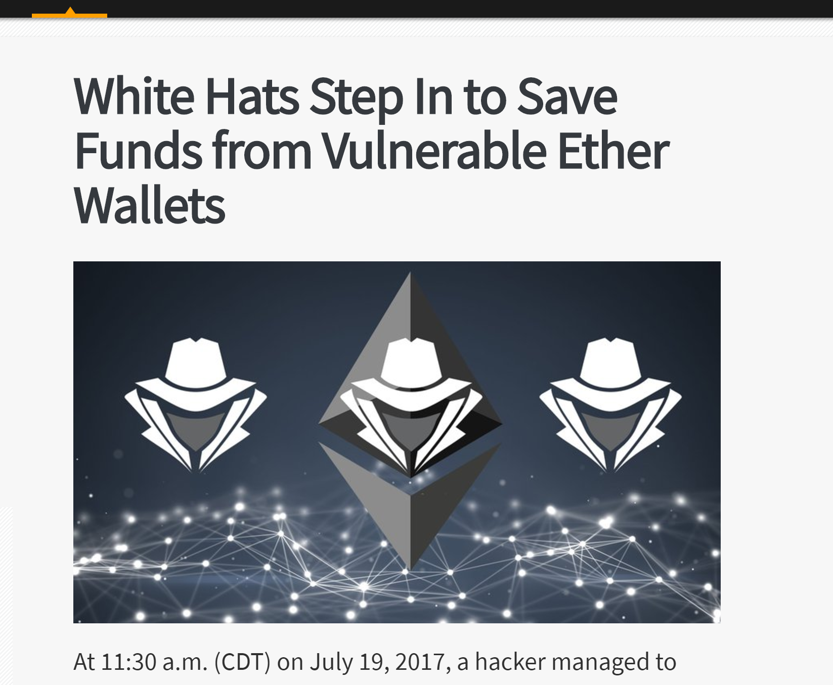
This Happened
Someone exploited exactly this opening
Started pumping money out …
“White hat” hackers notice, exploit same opening to pump money out to save victims
Final Score
Black hats: 153K ETH, White Hats: 377K ETH

Slide 24
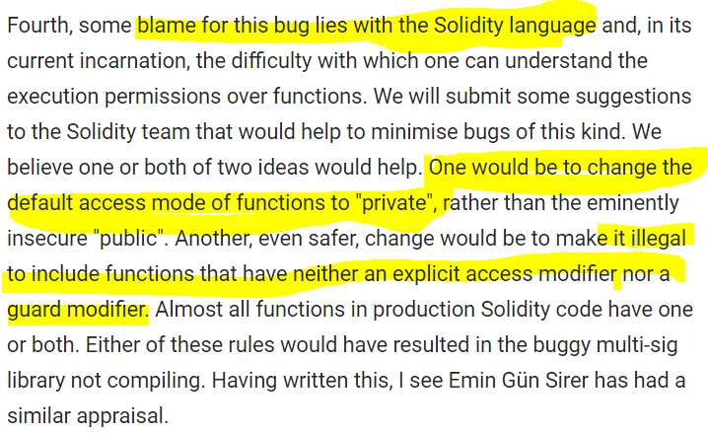
Blame & Prevention
Default visibility now internal
Compiler now complains if function visibility declarations not explicit
Moral
Designing languages for mission-critical apps is not for amateurs.

Slide 25
False Randomness Attack
Gambling is very popular in Ethereum
Gambling requires randomness
Blockchains require determinism
Check your wallet

Slide 26
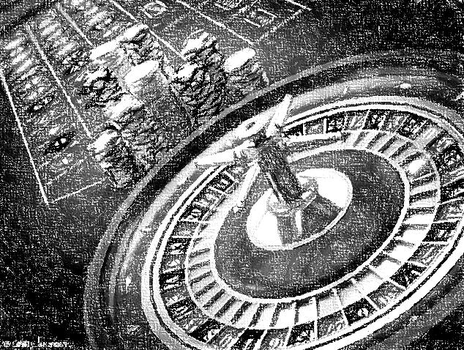
What are the Chances?
Clients bet or RED or BLACK
Last block hash even: RED
Last block hash odd: BLACK
What could go wrong?

Slide 27

Mining
bet on RED

Slide 28
Mining
Try nonce = 1
bet on RED
Try nonce = 2
Try nonce = 3
But hash is odd
Eureka!
I mined a block!
Suppress that block,
try again …

Slide 29
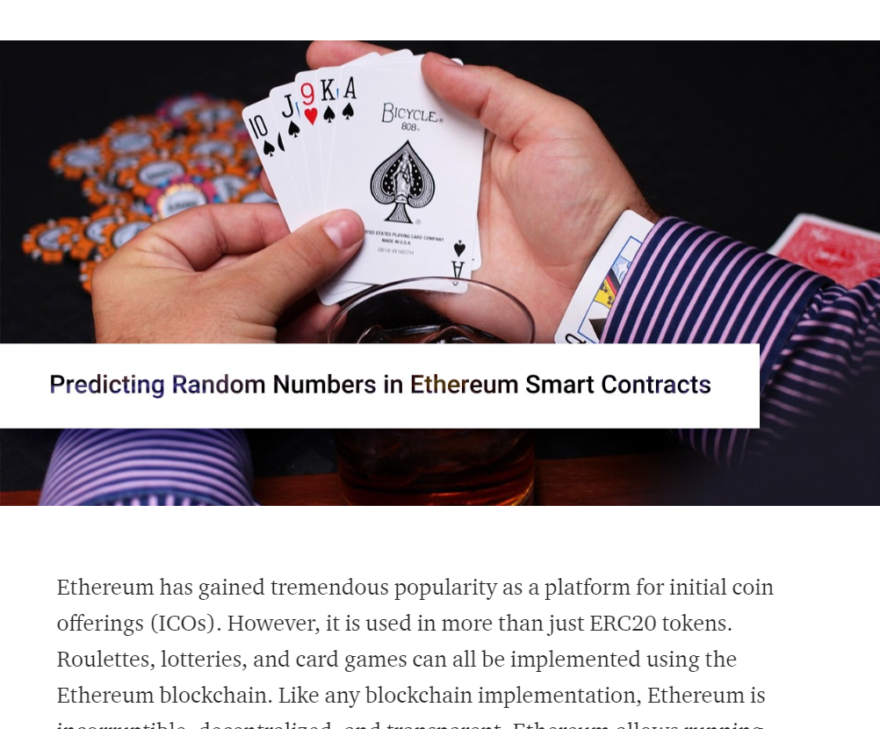
Examined 3,649 smart contracts in 2018
78 unique PRNG implementations
43 identified as vulnerable
A. Reutov, Predicting Random Numbers in Ethereum Smart Contracts

Slide 30
Block Variables
block.number
block.coinbase
block.gaslimit
block.difficulty
Not just miners can predict …
Attacker contract makes delegatecall to target contract, gets same “random” values

Slide 31
Hash of Current Block
function random(uint64 upper) public
returns (uint64 randomNumber) {
_seed = uint64(keccak256(keccak256(
block.blockhash(block.number))));
return _seed % upper;
}

Slide 32
Hash of Current Block
function random(uint64 upper) public
returns (uint64 randomNumber) {
_seed = uint64(keccak256(keccak256(
block.blockhash(block.number))));
return _seed % upper;
}
start with hash of current block …

Slide 33
Hash of Current Block
function random(uint64 upper) public
returns (uint64 randomNumber) {
_seed = uint64(keccak256(keccak256(
block.blockhash(block.number))));
return _seed % upper;
}
… hash it a few more times
Can you spot the problem?

Slide 34
Hash of Current Block
This expression always evaluates to 0!
function random(uint64 upper) public
returns (uint64 randomNumber) {
_seed = uint64(keccak256(keccak256(
block.blockhash(block.number))));
return _seed % upper;
}
block hash of block being created is (obviously) unknown to EVM

Slide 35
Hash of Earlier Block?
block.blockhash(block.number - 1)
Attacker can delegatecall contract to predict its “random” number

Slide 36
Hash of Future Block
Let’s play a game
Player makes bet, house stores transaction’s block.number
Player later asks house to announce winning number
House computes blockhash from saved block.number, then generates pseudo-random number

Slide 37
Hash of Future Block
“The block hashes are not available for all blocks for scalability reasons. You can only access the hashes of the most 256 blocks, all other values will be zero.”
Player requests winning number 256 blocks later
House computes blockhash 0, then generates totally predictable pseudo-random number

Slide 38
Window of maybe random block hashes
not
random
not
random
random
(maybe)
time
now-256
now-1
now

Slide 39


This Happened
Huge ICO “provably fair” lottery

Slide 40
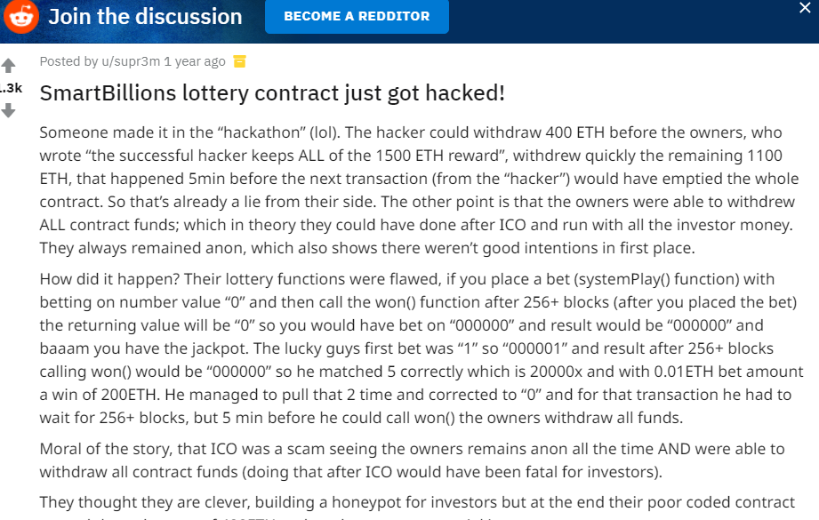
This Happened
Huge ICO “provably fair” lottery
Issued a “hackathon challenge”
Hacked by 256-block delay described
Arguably, the challenge was a success!

Slide 41
Blockhash with Private Seed
From the Slotthereum Lottery
bytes32 _a =
block.blockhash(block.number - secret);
for (uint i = 31; i >= 1; i--) {
if ((uint8(_a[i]) >= 48)
&& (uint8(_a[i]) <= 57)) {
return uint8(_a[i]) - 48;
}
}
this variable declared private so can’t be read by another contract
Like all blockchain data, trivial to read off-chain

Slide 42
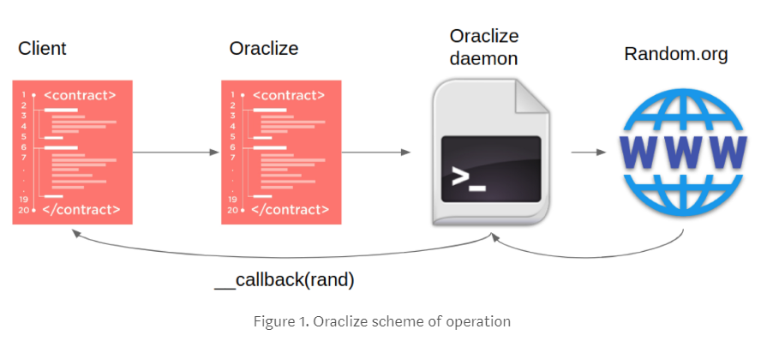
Prevention
Use External Oracle for Randomness
(trusted by all parties)

Slide 43
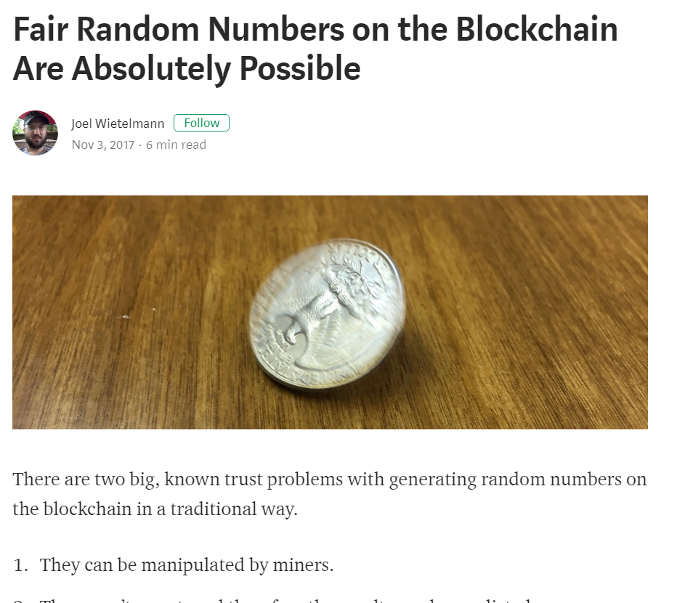
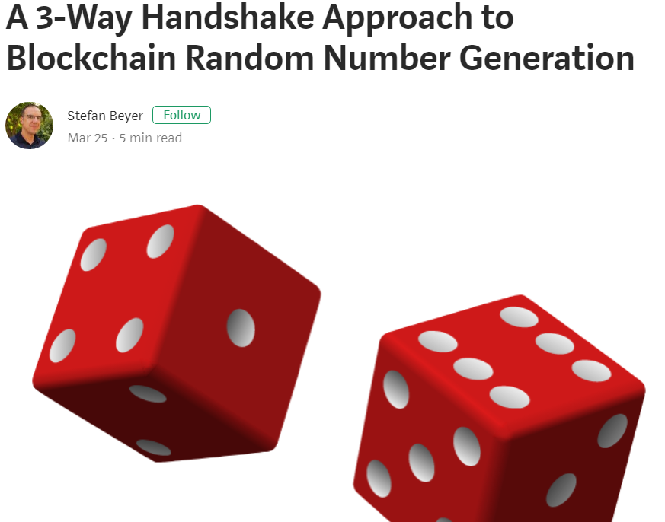
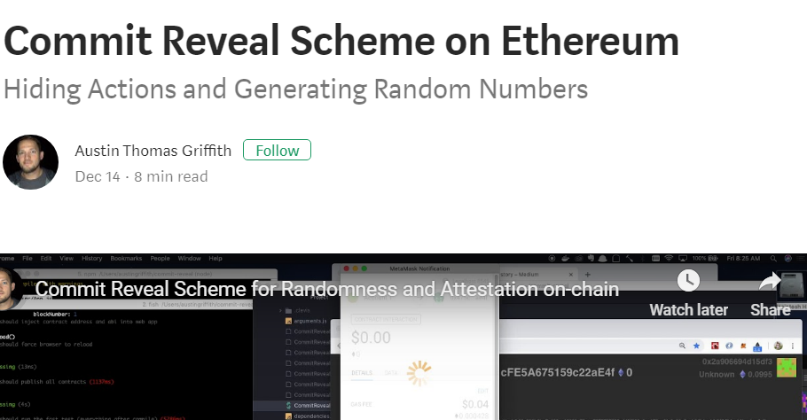
Prevention
Commit-Reveal Algorithms like we saw earlier

Slide 44
Unchecked CALL Return Values
Inconsistent interfaces for ether transfer:
If transfer() fails, caller reverts
If send() or call() fails, caller does not revert, instead gets Boolean return code
Unchecked return codes as attack vector

Slide 45

If something goes terribly wrong …
Out of gas
Assertion violated
stack overflow
The function call reverts
Rolling back that transaction’s effects

Slide 46
Normally if a function call reverts:
The entire call-chain reverts
Exceptions:
call(), delegatecall(), codecall()
Return Booleans instead of propagating

Slide 47
Gas Trap
if (! someAddr.call.value(100)()) {
// some failure code
}
Might burn all your gas
if (! someAddr.send(100)) {
// some failure code
}
Burns max 2300 gas (not much)

Slide 48
Prevention
If possible, use transfer() instead of send()
Otherwise, check return codes!
Use withdrawal pattern, where clients claim refunds via function calls

Slide 49
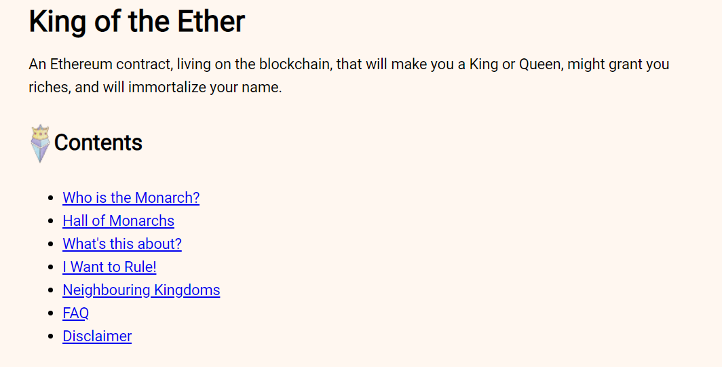
This Happened
King of the Ether (KotET) game
You pay to become king
KotET sends your ETH minus commission to previous monarch
You are now monarch
Claim price now goes up
You get paid when someone else becomes K/Q

Slide 50
This Happened
Payments were sent by unchecked sends
send() did not include enough gas for payment processing by wallet accounts
Recipient reverted, and payment was returned to contract
KotET contract didn’t revert, nor check return code
Proceeded without paying previous monarch

Slide 51
Stack Depth Attack
Stack Depth cannot exceed 1024
Artificially create stack depth of 1023, then pay to become king.
Refund payments to predecessor guaranteed to fail at depth 1025
Unchecked send() not just bug, but attack vector

Slide 52
Stack Depth Attack
Stack Depth attack no longer feasible
New rule: call cannot consume more then 63/64 of parent’s gas
If starts with g gas, after n calls you have at most g (63/64)^{n} gas available

Slide 53
Parameter Attack
Parameters to calls encoded by “ABI” specification
Possible to send shorter than expected encodings
EVM silently pads 0s at end of short parameters

Slide 54
Generate address with trailing 00:
0xcafecafecafecafecafecafecafecafecafe0000
On average, takes 256 tries

Slide 55

Deposit 100 coins
to 0xcafe…cafe0000!
OK, address
0xcafe…cafe0000
now has 100 coins
Contract
Total coins
Bal: 100
Add 100 coins to balance

Slide 56
Withdraw 100 coins
From 0xcafe…cafe0000!
OK, address
0xcafe…cafe0000
has 100 coins
Bal: 100

Slide 57
Withdraw 100 coins
From 0xcafe…cafe0000!
OK, address
0xcafe…cafe0000
has 100 coins
Contract
Total coins
Bal: 0
Debit 100 coins from balance

Slide 58
Contract
Total coins
Here are your 100 coins!

Slide 59
Withdraw 100 coins
From 0xcafe…cafe00!
(dropped 00 from address)
OK, address
0xcafe…cafe0000
has 100 coins
(padded 00 to address)
Bal: 100
(I do not validate address parameter!)

Slide 60
send
“transfer 100 coins
to 0xcafe…cafe0000”
Contract
Total coins
order of arguments: address then amount
function transfer(address to, uint tokens)
public returns (bool success);

Slide 61
a9059cbb000000000000000000000000cafecafecafecafecafecafecafecafecafe00000000000000000000000000000000000000000000000000056bc75e2d63100000
Contract
Total coins
functionaddressamount

Slide 62
Message Padded with 00
Encoded as:
a9059cbb000000000000000000000000cafecafecafecafecafecafecafecafecafe000000000000000000000000000000000000000000000000056bc75e2d6310000000
Should have been:
a9059cbb000000000000000000000000cafecafecafecafecafecafecafecafecafe00000000000000000000000000000000000000000000000000056bc75e2d63100000
This missing byte…
Replaced with this

Slide 63
send
“transfer 100 coins
to 0xcafe…cafe0000”
Contract
Total coins
decoded as
“transfer 256 X 100 coins
to 0xcafe…cafe0000”

Slide 64
Contract
Total coins
Here are your 256 X 100 coins!

Slide 65
Prevention
modifier onlyPayloadSize(uint size) {
if(msg.data.length < size + 4) {
revert;
}
_;
}
function transfer(address _to, uint _value)
onlyPayloadSize(2 * 32)
returns (bool success) { … }
Validate inputs before sending anything to a contract

Slide 66

Ideas we covered in this lecture
Default Visibility
False Randomness
Unchecked return values
Parameter Attack

Slide 67
